Slide 1
Path Finder Q - learning algorithm
Pavan Kumar Battula
Keerthi Kambam

Slide 2
Topic of Interest
Brief understanding of Reinforcement learning and Q-learning algorithm
Explaining Q-learning algorithm with an example.
Simple Q-learning algorithm Vs Q-learning algorithm with a heuristic function
Test metrics
learning curve of an agent over the episodes
total rewards
total regrets

Slide 3
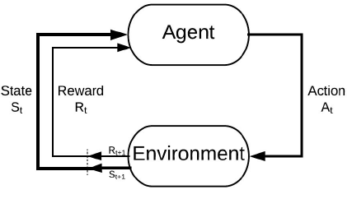
Reinforcement learning
Reinforcement Learning is the branch of science which makes optimal decisions using experiences of an agent. It involves these simple steps:
Observing the environment
Deciding how to act using some strategy
Acting accordingly
Receiving a reward or penalty
Learning from the experiences and refining our strategy
Iterate until an optimal strategy is found

Slide 4
Reinforcement learning
There are 2 main types of RL algorithms. They are model-based and model-free.
A model-free algorithm is an algorithm that estimates the optimal policy without using or estimating the dynamics (transition and reward functions) of the environment.
Ex: Q-learning algorithm
Whereas, a model-based algorithm is an algorithm that uses the transition function (and the reward function) in order to estimate the optimal policy.
Ex: RL environment using Random Forest algorithm

Slide 5
Q-learning algorithm
Q*(s,a) is the expected value (cumulative discounted reward) of doing action a in state s and then following the optimal policy.
Q-learning uses Temporal Differences(TD) to estimate the value of Q*(s,a). Temporal difference is an agent learning from an environment through episodes with no prior knowledge of the environment.
The agent maintains a table of Q[S, A], where S is the set of states and A is the set of actions.
Q[s, a] represents its current estimate of Q*(s,a).

Slide 6
Q-Table
Q-Table is the data structure used to calculate the maximum expected future rewards for action at each state.
Basically, this table will guide us to the best action at each state. To learn each value of the Q-table, Q-Learning algorithm is used.

Slide 7
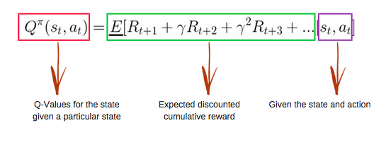
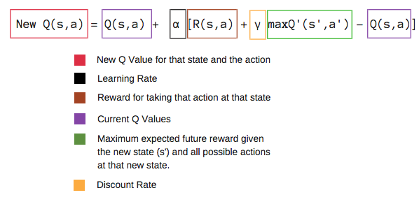
Q-function
The Q-function uses the Bellman equation and takes two inputs: state (s) and action (a).

Slide 8
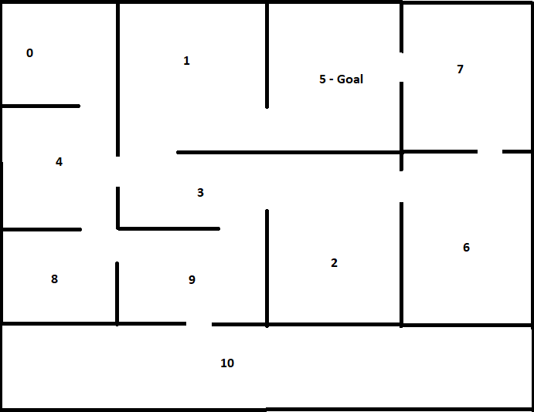
Q-learning with an example
Below is the grid designed to train the agent in reaching the goal state with an optimal policy.

Slide 9
Path finder execution with Q-learning algorithm
Step1#Initialize the Q-table
def initialize_q(m,n):
return np.zeros((m,n))
q_matrix = initialize_q(11,11)
pd.DataFrame(q_matrix)
0 | 1 | 2 | 3 | 4 | 5 | 6 | 7 | 8 | 9 | 10
0 | 0.0 | 0.0 | 0.0 | 0.0 | 0.0 | 0.0 | 0.0 | 0.0 | 0.0 | 0.0 | 0.0
1 | 0.0 | 0.0 | 0.0 | 0.0 | 0.0 | 0.0 | 0.0 | 0.0 | 0.0 | 0.0 | 0.0
2 | 0.0 | 0.0 | 0.0 | 0.0 | 0.0 | 0.0 | 0.0 | 0.0 | 0.0 | 0.0 | 0.0
3 | 0.0 | 0.0 | 0.0 | 0.0 | 0.0 | 0.0 | 0.0 | 0.0 | 0.0 | 0.0 | 0.0
4 | 0.0 | 0.0 | 0.0 | 0.0 | 0.0 | 0.0 | 0.0 | 0.0 | 0.0 | 0.0 | 0.0
5 | 0.0 | 0.0 | 0.0 | 0.0 | 0.0 | 0.0 | 0.0 | 0.0 | 0.0 | 0.0 | 0.0
6 | 0.0 | 0.0 | 0.0 | 0.0 | 0.0 | 0.0 | 0.0 | 0.0 | 0.0 | 0.0 | 0.0
7 | 0.0 | 0.0 | 0.0 | 0.0 | 0.0 | 0.0 | 0.0 | 0.0 | 0.0 | 0.0 | 0.0
8 | 0.0 | 0.0 | 0.0 | 0.0 | 0.0 | 0.0 | 0.0 | 0.0 | 0.0 | 0.0 | 0.0
9 | 0.0 | 0.0 | 0.0 | 0.0 | 0.0 | 0.0 | 0.0 | 0.0 | 0.0 | 0.0 | 0.0
10 | 0.0 | 0.0 | 0.0 | 0.0 | 0.0 | 0.0 | 0.0 | 0.0 | 0.0 | 0.0 | 0.0

Slide 10
Path finder execution with Q-learning algorithm
Step2# Choose an Action
Step 3# Perform an Action
Both step2 and step3 are performed in a continuous pattern for specified number of iterations, which we decide to train the agent in the environment.
Step 4 : Measure Reward
q_current_state= cur_state_reward+(gamma*nxt_state_reward)
Step 5 : Evaluate

Slide 11
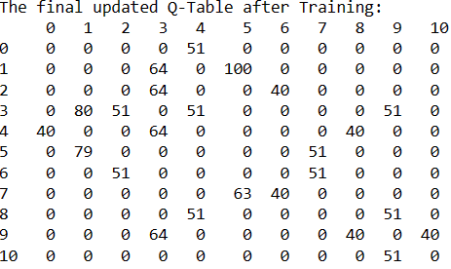
Path finder execution with Q-learning algorithm
Below is the updated q-table after sufficient training of the agent.
Q-table is normalized for better understanding.

Slide 12
Exploration Vs Exploitation
Exploration is trying new possibilities in order to find better rewards.
Exploitation is to keep opting for same actions that has given some significant rewards in the past.
During the process of exploration, the agent progressively becomes more confident in estimating the Q-values.

Slide 13
Path finding execution with Q-learning Heuristic function
As the grid dimensions scale up in the real world, computation involved in this calculations becomes more challenging.
We need approximations using linear functions or heuristic functions to optimize the Q-learning algorithm.
In this example, we are using a heuristic function which cuts downs the agent transitions making a note of already visited states from a set of valid actions declared for the agent in the grid.

Slide 14
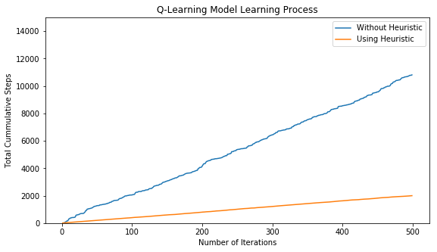
Path Finder agent learning progress using Q-learning algorithm
Without any heuristic function, agent’s learning rate is steeply increased for given 500 episodes of training making total of 10,000 state transitions.
But with a heuristic function, for the same 500 episodes of training, agent only made 2000 state transitions to finish the same level of training.

Slide 15
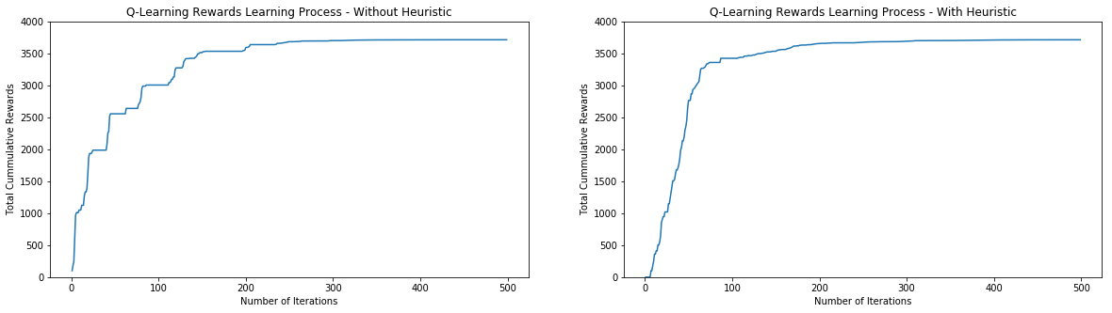
Path finder agent Total rewards Without Heuristic Vs With Heuristic
From the below graphs, when analysed, total rewards gained by the agent are high from the first 50 iterations of training when a heuristic function is applied.

Slide 16
Conclusion
Q-Learning Model using Heuristic function outperfom the Simple Q-Learning Model in terms of performance.
We can see the huge reduction of total number of time steps for Q-Learning Model using Heuristic Function.
Agent learns quickly in Q-Learning Model using Heuristic

